Slide 1
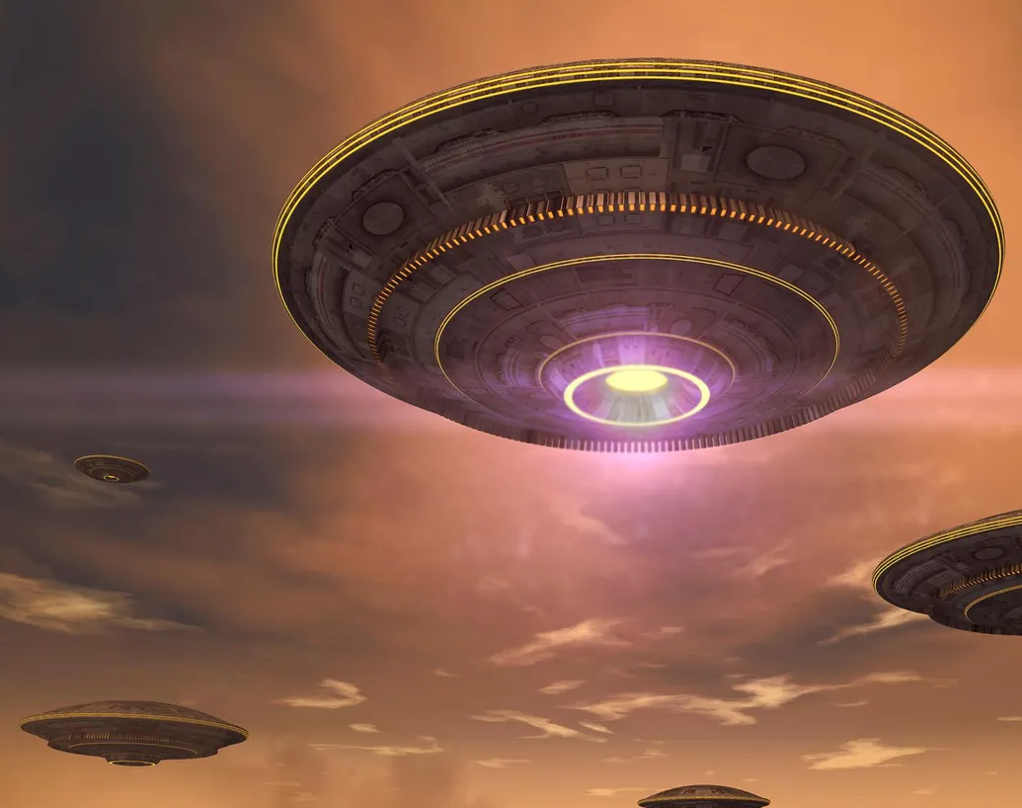
Assault
Created by:
Dakota Cook
Chris Ulmer
Daniel Tager

Slide 2

Tools
Unity Version 2022 – higher
Unity Asset Store
AI Navmesh API
OneDrive
Discord/Discord Screenshare

Slide 3

The Map
Used a base asset for the start of the map design
Modified the map to have:
  More locations to access
  More water hazards
  Thinner paths in certain areas
  Trimmed down terrain edges to keep the play area more linear
  Monsters that roam to eliminate you

Slide 4



The UI
Start menu with instructions
Dynamic compass that grows and shrinks with distance from items
Close to item
Far from item
Score display while game is active
Controls at the bottom of the screen
Death menu that displays your final score and allows you to either play again or quit the game

Slide 5

The Game
Capture the Flag inspired
Pick up randoms items around the map and bring them back to the UFO for points
Run away from strange lifeforms to avoid being eaten
Parkour around bridges and waterways
Infinite game time, lasts until you die
No pausing, it’s part of the challenge

Slide 6

What Each Of Us Worked On
Dan – End game scripting, restart game scripting, monster AI scripting, Navmesh placement
Chris – Item scripting, goal scripting, player controller scripting
Dakota – Design of the map, placement of spawns, UI and UI scripting, placement of monsters, water hazard scripting

Slide 7

Any Additional Questions?

